Slide 1
Router Construction
Outline
  Switched Fabrics
  IP Routers
  Extensible (Active) Routers

Slide 2
Workstation-Based
Aggregate bandwidth
  1/2 of the I/O bus bandwidth
  capacity shared among all hosts connected to switch
  example: 800Mbps bus can support 8 T3 ports
Packets-per-second
  must be able to switch small packets
  100,000 packets-per-second is achievable
  e.g., 64-byte packets implies 51.2Mbps
I/O bus
CPU
Interface 1
Interface 2
Interface 3
Main memory

Slide 3
Switching Hardware
Design Goals
  throughput (depends on traffic model)
  scalability (a function of n)
Ports
  circuit management (e.g., map VCIs, route datagrams)
  buffering (input and/or output)
Fabric
  as simple as possible
  sometimes do buffering (internal)
Input
Output
port
port
Input
Output
port
port
Fabric
Input
Output
port
port
Input
Output
port
port

Slide 4
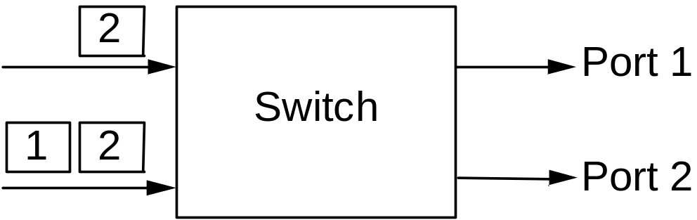
Buffering
Wherever contention is possible
  input port (contend for fabric)
  internal (contend for output port)
  output port (contend for link)
Head-of-Line Blocking
  input buffering

Slide 5
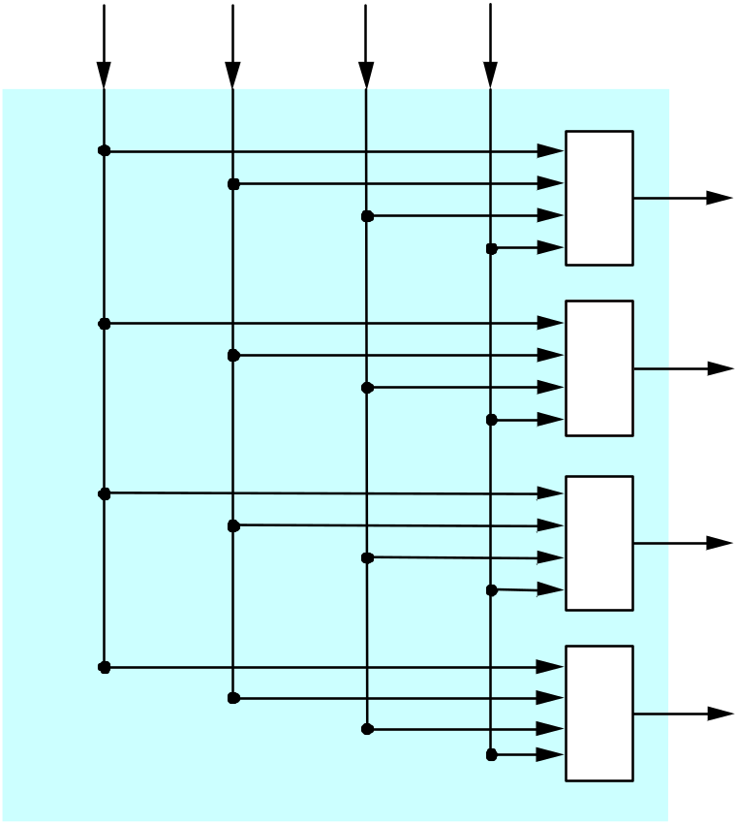
Crossbar Switches

Slide 6
Knockout Switch
Inputs
Example crossbar
Concentrator
  select l of n packets
Complexity: n²
D
D
D
D
D
D
D
D
D
D
D
D
D
D
1
2
3
4
Outputs

Slide 7
Knockout Switch (cont)
Output Buffer
Shifter
(a)
Buffers
Shifter
(b)
Buffers
Shifter
(c)
Buffers

Slide 8
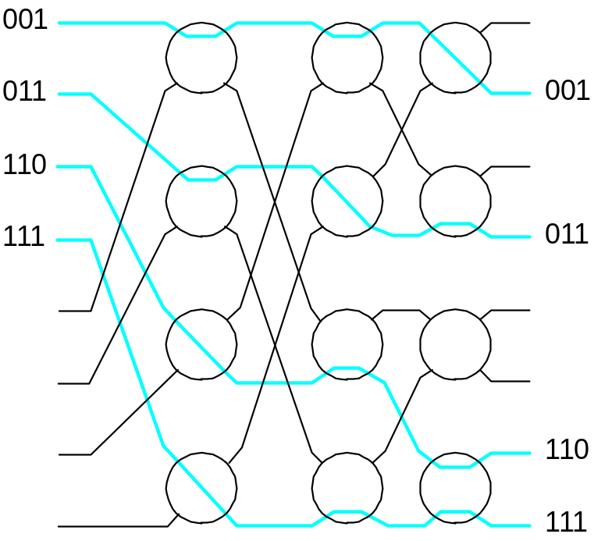
Self-Routing Fabrics
Banyan Network
  constructed from simple 2 x 2 switching elements
  self-routing header attached to each packet
  elements arranged to route based on this header
  no collisions if input packets sorted into ascending order
  complexity: n log₂ n

Slide 9
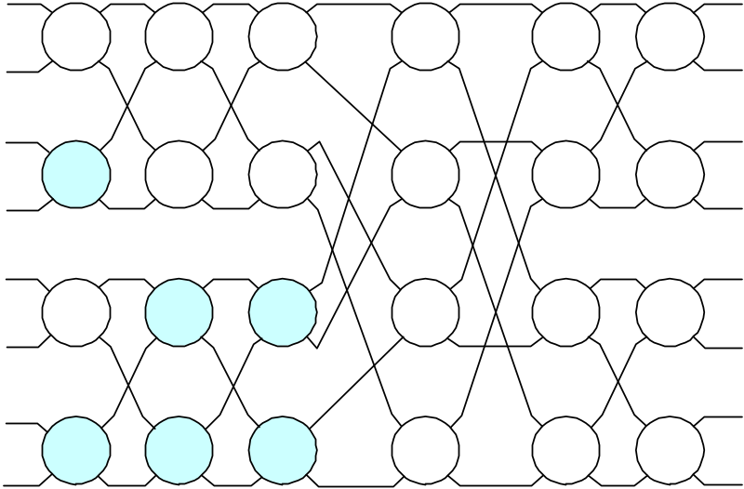
Self-Routing Fabrics (cont)
Batcher Network
  switching elements sort two numbers
    some elements sort into ascending (clear)
    some elements sort into descending (shaded)
  elements arranged to implement merge sort
  complexity: n log²₂ n
Common Design: Batcher-Banyan Switch

Slide 10
High-Speed IP Router
Switch (possibly ATM)
Line Cards + Forwarding Engines
  link interface
  router lookup (input)
  common IP path (input)
  packet queue (output)
Network Processor
  routing protocol(s)
  exceptional cases

Slide 11
High-Speed Router
Routing software
w/ router OS
Line card
(forwarding
buffering)
Routing
CPU
Buffer
memory
Line card
(forwarding
buffering)
Line card
(forwarding
buffering)
Line card
(forwarding
buffering)

Slide 12
Alternative Design
NI with
uP
PC
PC
NI with
uP
CPU
CPU
.
.
.
.
.
.
MEM
MEM
NI with
uP
NI with
uP
NI with
uP
PC
PC
NI with
uP
CPU
Crossbar
Switch
CPU
.
.
.
.
.
.
MEM
MEM
NI with
uP
NI with
uP
NI with
uP
PC
PC
NI with
uP
CPU
CPU
.
.
.
.
.
.
MEM
MEM
NI with
uP
NI with
uP

